Slide 1


Massive MIMO Systems: Signal Processing Challenges and Research Trends
Rodrigo C. de Lamare
CETUC, PUC-Rio, Brazil
Communications Research Group,
Department of Electronics, University of York, U.K.
delamare@cetuc.puc-rio.br

Slide 2
Outline
Introduction
Application Scenarios and Signal Models
  Satellite, cellular and local area networks
  Downlink and uplink Models
Transmit Processing Strategies
  TDD operation
  Pilot contamination
  Resource allocation
  Precoding
Receive Processing Techniques
  Parameter estimation
  Detection algorithms
  Error control coding
  Mitigation of RF impairment
Future Trends and Emerging Topics
Concluding Remarks

Slide 3
Introduction (1/2)
Wireless networks are experiencing a huge increase in the delivered amount of data due to emerging applications: M2M, video, etc.
Key problems: High data rates require extra spectrum and energy which are very scarce, scalability of devices and signal processing algorithms.
Future networks will require techniques that can substantially increase the capacity (bits/Hz) whilst not requiring extra spectrum or extra energy.
Massive MIMO is a potential solution to these problems:
  Very large arrays with an order of magnitude higher number of sensors.
  Deployment of devices (access points, mobile phones and tables) with a large number of antenna elements.
  Huge multiplexing gains allowing an order of magnitude higher data rates.
T. L. Marzetta, “Noncooperative cellular wireless with unlimited numbers of base station antennas,” IEEE Trans. Wireless Commun., vol. 9, no. 11, pp. 3590–3600, Nov. 2010.

Slide 4
Introduction (2/2)
Massive MIMO networks will be structure around the following elements:
Antennas:
  Reduction of RF chains and costs,
  Compact antennas and mitigation of coupling effects.
Electronic components:
  Low-cost components such as power amplifiers and RF components.
  Flexibility for different air interfaces and replacement of coaxial cables.
Network architectures:
  Heterogeneous networks, small cells and network MIMO,
  Cloud radio access networks to help different devices.
Protocols:
  Scheduling and medium-access protocols for numerous heterogeneous users.
Signal processing:
  Transmit and receive processing,
  Scalability and hardware implementation,
  Integration between signal processing and RF devices to deal with impairments.

Slide 5
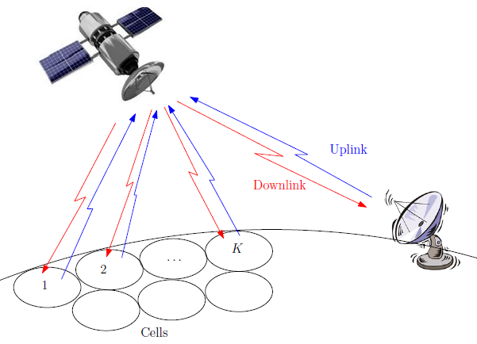
Application Scenarios: Satellite Networks
Multi-beam satellite systems:
  Clear and well-defined scenario for massive MIMO.
  Coverage region is served by multiple spot beams intended for the users .
  Beams are shaped by the antenna feeds forming part of the payload.
Research problem:
  interference caused by multiple adjacent spot beams that share the same frequency band.
Interference mitigation:
  Precoding for the forward link that needs CSI.
  Detection algorithms for the reverse link.
J. Arnau, B. Devillers, C. Mosquera, A. Prez-Neira, “Performance study of multiuser interference mitigation schemes for hybrid broadband multibeam satellite architectures”, EURASIP Journal on Wireless Communications and Networking, 2012:132 (5 April 2012).

Slide 6
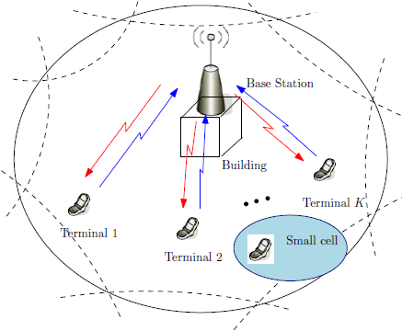
Application Scenarios: Mobile Cellular Networks
5G mobile cellular networks:
  Base stations: very large arrays placed on rooftops and façades.
  User terminals: phones, tablets with a significant number of antenna elements.
  Compact antennas: mutual coupling
  Coordination between cells.
  Operation in TDD Mode.
Research problems:
  Uplink channel estimation: use of non-orthogonal pilots, the existence of adjacent cells and the coherence time of the channel require the system to reuse the pilots.
  Pilot contamination: occurs when the CSI at the base station in one cell is affected by users from other cells.
Topics for investigation:
  Design of channel estimation strategies that avoid pilot contamination.
  Design of precoding and detection algorithms for Network MIMO with large arrays.
J. Jose, A. Ashikhmin, T. L. Marzetta, S. Vishwanath, “Pilot Contamination and Precoding in Multi-Cell TDD Systems,” IEEE Transactions on Wireless Communications, vol.10, no.8, pp. 2640-2651, August 2011.

Slide 7
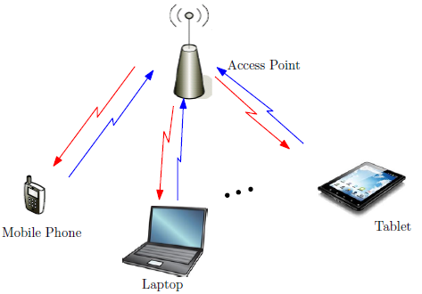
Application Scenarios: Local Area Networks
Future wireless local area networks:
  Tremendous increase in the last years with the proliferation of access points (APs) in hot spots and home users.
  IEEE 802.11ac: MIMO-OFDM with 20 or 40 MHz, up to 8 antennas at APs, 64 subcarriers which are not all used.
  Massive MIMO: compact antennas, planar array geometries, etc.
Research problems:
  Coupling effects and I/Q imbalances.
  Physical dimensions of APs and user devices.
Topics for investigation:
  Coupling must be mitigated by DSP or smart RF solutions.
  Design of efficient precoding and detection algorithms.
  Design of decoding algorithms with reduced delay.
Wireless LAN Medium Access Control (MAC) and Physical Layer (PHY) Specifications: Enhancements for Very High Throughput for
Operation in Bands Below 6GHz, IEEE P802.11ac/D1.0 Stdandard., Jan. 2011

Slide 8

Signal Models: Downlink Case
Multiuser massive MIMO system:
  N_{A} antennas at the transmitter (satellite gateway, base station or WLAN AP).
  K users and each is equipped with N_{U} antennas.
Fundamental massive MIMO scenarios:
  When N_{A} >> KN_{U} -> excess degrees of freedom leverages array gain
  When N_{A} ~ KN_{U} -> absence of extra degrees of freedom
Precoded data:
  KN_{U} x 1 data vector s[i] = [s₁ ^{T}[i] … s_{k}^{T} [i]… s_{K}^{T} [i]] ^{T}
  N_{A} x 1 precoded data x_{k}[i] = P (s_{k}[i]) ,
where each symbol s_{i} ϵ A = {a₁ , … , a_{N} }, has zero mean and variance σ_{s}².
Received data:
  N_{U} x 1 received vector
where H_{k} is the N_{U} x N_{A} channel matrix and n_{k} is the N_{U} x 1 noise vector.

Slide 9

Signal Models: Uplink Case
Multiuser massive MIMO system:
  N_{A} antennas at the receiver (satellite gateway, base station or WLAN AP).
  K users and each is equipped with N_{U} antennas.
Fundamental massive MIMO scenarios:
  When N_{A} >> KN_{U} -> excess degrees of freedom leverages array gain
  When N_{A} ~ KN_{U} -> absence of extra degrees of freedom
Received data with sufficient statistics:
  N_{A} x 1 received vector
where H_{k} is the N_{A} x N_{U} channel matrix and n is the N_{A} x 1 noise vector.

Slide 10
Transmit Processing
Optimal transmit strategy:
  Requires CSI, obtained either by feedback channels or reciprocity.
  Dirty paper coding.
  Implicit scheduling and power allocation.
  Very costly and impractical.
Practical strategies:
  TDD mode.
  Pilot contamination.
  Resource allocation.
  Precoding techniques.
G. Caire and S. Shamai (Shitz), “On the achievable throughput of a multiantenna Gaussian broadcast channel,” IEEE Trans. Inform. Theory, vol. 49, no. 7, pp. 1691–1706, July 2003.
A. Ashikhmin and T. L. Marzetta, “Pilot contamination precoding in multi-cell large scale antenna systems,” in IEEE International Symposium on Information Theory (ISIT), Cambridge, MA, Jul. 2012.

Slide 11
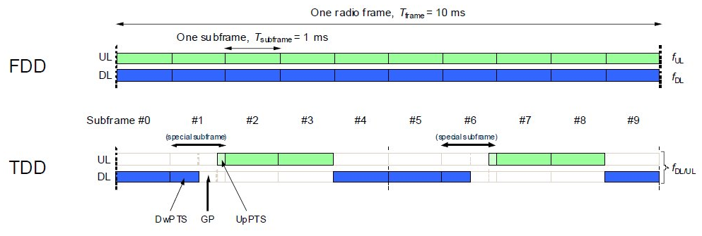
Operation in TDD Mode
  Does not require feedback channels to acquire CSI
  Rely on reciprocity to obtain CSI at the either the Tx or the Rx.
      In Massive MIMO CSI is obtained at the base station or AP.
      Problem with the amplifiers and filters that are different.
  Independent from the number of antennas N_{A} at the base station or AP.
      In FDD the CSI feedback requirements are proportional to the number of antennas.
      In Massive MIMO it is more likely the use of TDD to eliminate the need for CSI feedback.
  Research problems:
      Calibration and measurement techniques.
X. Gao, F. Tufvesson, O. Edfors, and F. Rusek, “Measured propagation characteristics for very-large MIMO at 2.6 GHz,” in Proc. of the 46th Annual Asilomar Conference on Signals, Systems, and Computers, Pacific Grove, California, USA, Nov. 2012.

Slide 12
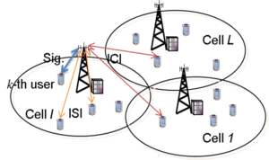
Pilot Contamination
Adoption of TDD, network MIMO and uplink training -> phenomenon called Pilot Contamination.
In multi-cell scenarios, it is difficult to employ orthogonal pilot sequences because their duration depends on the number of cells.
The duration of the sequences is limited by the channel coherence time.
Therefore, non-orthogonal pilot sequences are likely to be employed and this affects the CSI accuracy employed at the transmitter.
Specifically, CSI is contaminated by a linear combination of channels of other users that share the same pilot.
Consequently, the precoders and resource allocation will be highly affected by the contaminated CSI.
Research problems:
  Design of innovative training schemes
  Design of precoders and resource allocation algorithms that can deal with pilot contamination.
A. Ashikhmin and T. L. Marzetta, “Pilot contamination precoding in multi-cell large scale antenna systems,” in IEEE International Symposium on Information Theory (ISIT), Cambridge, MA, Jul. 2012.

Slide 13
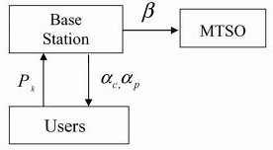
Resource Allocation
Key resources such as antennas, users and power: must be allocated based on the instantaneous CSI of users and a metric.
In massive MIMO systems, the spatial signatures of the users to be scheduled play a fundamental role -> they are quasi orthogonal.
The multiuser diversity along with high array gains might be exploited by resource allocation algorithms along with timely CSI.
Problem of user selection: scheduling is a combinatorial problem equivalent to the combination of K choosing Q.
When K in the system is reasonably large: we need cost-effective user selection algorithms.
Research problems:
  Strategies based on greedy, low-cost and discrete optimization methods.
  Chunk strategies : aggregate certain parameters per groups of users to reduce cost.
N. Dao and Y. Sun, “User-selection algorithms for multiuser precoding,”
IEEE Trans. Veh. Technol., vol. 59, no. 7, Sep. 2010.

Slide 14


Precoding and Related Techniques (1/2)
Main goals:
  Mitigation of the multiuser interference.
  Increase in the achievable sum-rates.
Transmit matched filter:
the N_{A} x K N_{U} matrix H contains the parameters of all the channels and the N_{A} x 1 vector x[i] represents the data processed.
Linear precoding:
where the N_{A} x NU precoding matrix W_{k} is a function of the channels.
Block diagonalization precoding:
  Improved BER and sum-rate performance over linear MMSE or ZF precoding.
  Computational complexity of original BD is high for large systems.
K. Zu, R. C. de Lamare and M. Haardt, “Generalized design of low- complexity block diagonalization type precoding algorithms for multiuser MIMO systems”, IEEE Trans. Communications, 2013.

Slide 15



Precoding and Related Techniques (2/2)
Tomlinson-Harashima precoding:
where F is the N_{A} x K N_{U} feedforward matrix obtained by an LQ decomposition of the channel matrix H and the input is computed element-by-element by
where b_{lq} are the elements of the K N_{U} x K N_{U} lower triangular matrix B that can also be obtained by an LQ decomposition.
Vector perturbation precoding:
where W is a precoder such that Tr(W^{H}W) ≤ P, the scalar A depends on the constellation size and CZK is the K-dimensional complex lattice
K. Zu, R. C. de Lamare and M. Haardt , “Multi-Branch Tomlinson-Harashima Precoding Design for MU-MIMO Systems: Theory and Algorithm”, IEEE Trans. Communications, 2014 (to appear).

Slide 16
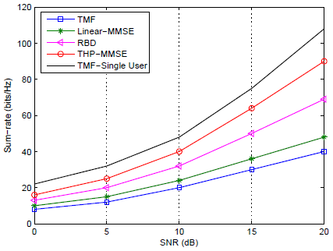
Simulation Results
Sum-rate performance against SNR of precoding algorithms
Scenario: N_{A} = 128, K = 8 users and N_{U} = 8 antenna elements

Slide 17
Receive Processing
Parameter estimation techniques:
  Channel estimation.
  Estimation of receive filter parameters.
Detection strategies:
  ML detection.
  Suboptimal detection.
Error control coding:
  Channel codes.
  Iterative detection and decoding.
Mitigation of RF impairments
  I/Q imbalances in the RF chains of large arrays.
  Mutual coupling between antenna elements in compact arrays

Slide 18
Parameter Estimation Techniques
Channel estimation:
  Semi-blind techniques to deal with pilot contamination.
  Superimposed training techniques.
Receive filter parameter estimation:
  Reduced-rank techniques.
  Sparsity-aware algorithms.
  Low-complexity adaptive techniques for estimating and tracking parameters in the presence of mobility.
H. Qian and S. N. Batalama, “Data-record-based criteria for the selection of an auxiliary vector estimator of the MMSE/MVDR filter,” IEEE Trans. Commun., vol. 51, no. 10, pp. 1700–1708, Oct. 2003.
Y. Sun, V. Tripathi, and M. L. Honig, “Adaptive, iterative, reduced-rank (turbo) equalization,” IEEE Trans. Wireless Commun., vol. 4, no. 6, pp. 2789–2800, Nov. 2005.
R. C. de Lamare and R. Sampaio-Neto, “Adaptive reduced-rank processing based on joint and iterative interpolation, decimation, and filtering,” IEEE Trans. Signal Process., vol. 57, no. 7, July 2009, pp. 2503-2514.
R.C. de Lamare and R. Sampaio-Neto, “Adaptive reduced-rank equalization algorithms based on alternating optimization design techniques for MIMO systems,” IEEE Trans. Veh. Technol., vol. 60, no. 6, pp. 2482-2494, July 2011.

Slide 19

Detection Techniques (1/2)
Main goal: to separate the data streams of the users at the receiver
Optimal ML detector:
where the KN_{U} x 1 data vector s[i] contains the symbols of all users.
The complexity of the ML detector grows exponentially with the constellation size and KN_{U}.
Sphere decoders are appealing in MIMO systems with small dimensions but are unlikely to be used in massive MIMO systems.
M. O. Damen, H. E. Gamal, and G. Caire, “On maximum likelihood detection and the search for the closest lattice point,” IEEE Trans. Inform. Theory, vol. 49, pp. 2389–2402, Oct. 2003.

Slide 20

Detection Techniques (2/2)
Linear detectors:
where W is the N_{A} x KN_{U} matrix receive filter applied to the received data
Decision feedback detectors:
where the receive filters W and F can be computed using various design criteria and optimization algorithms.
J. H. Choi, H. Y. Yu, Y. H. Lee, ”Adaptive MIMO decision feedback equalization for receivers with time-varying channels”, IEEE Trans. Signal Proc., 2005, 53, no. 11, pp. 4295-4303.
P. Li, R. C. de Lamare and R. Fa, “Multiple Feedback Successive Interference Cancellation Detection for Multiuser MIMO Systems,” IEEE Transactions on Wireless Communications, vol. 10, no. 8, pp. 2434 - 2439, August 2011.
P. Li and R. C. de Lamare, ”Adaptive Decision-Feedback Detection With Constellation Constraints for MIMO Systems”, IEEE Transactions on Vehicular Technology, vol. 61, no. 2, 853-859, 2012.

Slide 21
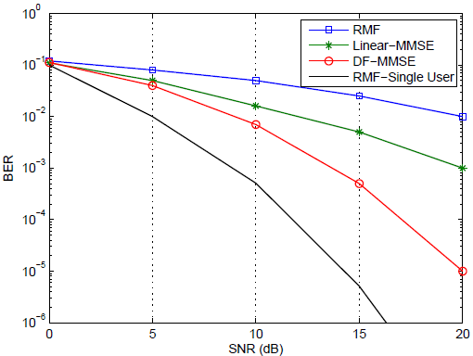
Simulation Results
BER performance against SNR of detection algorithms
Scenario: N_{A} = 128, K = 8 users and N_{U} = 8 antenna elements

Slide 22
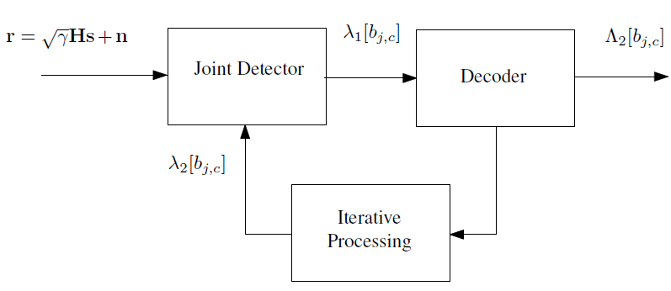
Error Control Coding
Choice of channel coding
  Convolutional codes.
  Turbo codes.
  LDPC codes.
Iterative detection and decoding
  Helps with interference mitigation.
Research problems
  Reducing the number of iterations.
  Improving the exchange of soft information.
H. Wymeersch, F. Penna and V. Savic, “Uniformly Reweighted Belief Propagation for Estimation and Detection in Wireless Networks,” IEEE Trans. Wireless Communications, vol. PP, No. 99, pp. 1-9, Feb. 2012.

Slide 23
Mitigation of RF Impairments
Coupling effects:
  Reduction of the physical size of antennas induces coupling.
  Coupling reduces the multiplexing gain and the degrades the performance.
I/Q imbalances:
  Phase offsets degrade the performance.
  Originate non-circular data.
Failures of antenna elements:
  Cheaper components may lead to more frequent failures.
  Reduction of the degrees of freedom.
  Signal processing algorithms should be able to cope with them.
T. Adali, P. J. Schreier and L. L. Scharf, “Complex-valued signal processing: the proper way to deal with impropriety”, IEEE Trans. Signal Processing, vol. 59, no. 11, pp. 5101–5125 , November 2011.
N. Song, R. C. de Lamare, M. Haardt, and M. Wolf, “Adaptive Widely Linear Reduced-Rank Interference Suppression based on the Multi-Stage Wiener Filter,” IEEE Transactions on Signal Processing, vol. 60, no. 8, 2012.

Slide 24
Future Trends and Emerging Topics
Transmit processing
  Cost-effective scheduling techniques: greedy techniques and discrete optimisation tools.
  Calibration techniques.
  Precoders with scalability in terms of complexity: use of transmit matched filters as the front-end.
Receive processing
  Cost-effective detection algorithms: use of the receive matched filter as the front-end.
  Reduced-delay decoding algorithms and IDD schemes.
  Mitigation of impairments: use of widely-linear processing.

Slide 25
Concluding Remarks
A tutorial on massive MIMO systems focusing on signal processing challenges and future trends in this exciting research topic has been given.
Key application scenarios which include multibeam satellite, cellular and local area networks have been examined along with several operational requirements of massive MIMO networks.
Transmit and receive processing tasks have been discussed and signal processing needs for future massive MIMO networks have been identified.
Numerical results have illustrated some of the discussions on transmit and receive processing functions and future trends have been highlighted.
Massive MIMO technology is likely to be incorporated into applications on a gradual basis by the increase in the number of antenna elements.

