Slide 1
Sparsity-Aware Adaptive Algorithms Based on Alternating Optimization and Shrinkage
Rodrigo C. de Lamare*⁺ and Raimundo Sampaio-Neto*
⁺ Communications Research Group, Department of Electronics, University of York, U.K.
* CETUC, PUC-Rio, Brazil
delamare@cetuc.puc-rio.br and raimundo@cetuc.puc-rio.br

Slide 2
Outline
Introduction
Problem statement and the oracle algorithm
Proposed alternating optimization with shrinkage scheme
Adaptive algorithms
Computational complexity
Statistical analysis
Simulation results
Conclusions

Slide 3
Introduction
Algorithms that can exploit sparsity have attracted a lot of interest in the last few years [1] and [2].
The basic idea is to exploit prior knowledge about the sparsity present in the data that need to be processed for several applications.
Key problem: existing methods often exhibit performance degradation as compared to the oracle algorithm.
We propose novel sparsity-aware adaptive filtering scheme and algorithms based on an alternating optimization strategy with shrinkage.
[1] Y. Gu, J. Jin, and S. Mei, “L0 Norm Constraint LMS Algorithm for Sparse System Identification,” IEEE Signal Processing Letters, vol. 16, pp. 774-777, 2009.
[2] Y. Chen, Y. Gu, and A. O. Hero, “Sparse LMS for system identification,” in Proc. of IEEE International Conference on Acoustics, Speech and Signal Processing, Apr. 19-24, 2009, pp. 3125-3128.

Slide 4
Problem statement
Sparse system identification problem:
The system observes an M × 1 vector x[i] at time instant I.
Output of the system: $d[i] = wHo x[i],$where $wo$ is an M-length FIR filter that represents the actual system.
Output of an adaptive filter: $\hat{d} [i] = wH[i]x[i]$
Optimization problem:

Slide 5
Oracle algorithm
It can identify the positions of the non-zero coefficients and fully exploit the sparsity of the system under consideration.
Optimization problem:
where is an M × M diagonal matrix with the actual K positions of the non-zero coefficients.
It requires an exhaustive search over all the possible K positions over M possibilities plus the computation of the optimal filter.

Slide 6
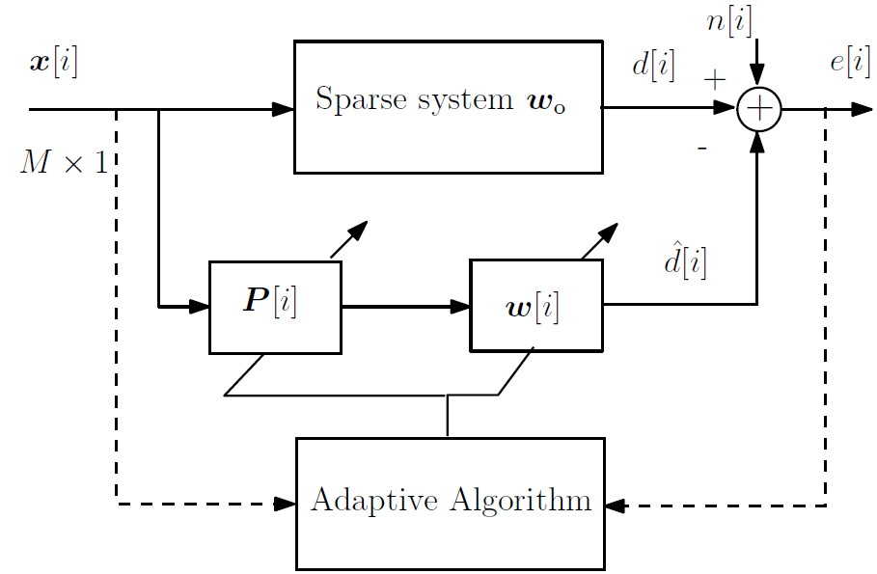
Proposed alternating optimization with shrinkage scheme
Two adaptive filters that are optimized in an alternating fashion:
The 1st adaptive filter p[i] performs the role of the oracle.
The 2nd adaptive filter w[i] estimates the non-zero parameters.
Output of the proposed scheme:

Slide 7
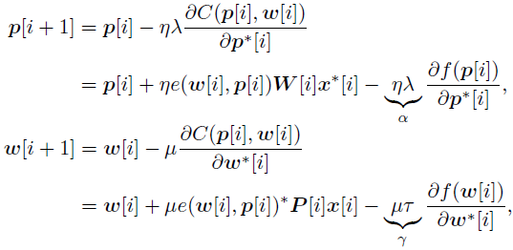
Adaptive algorithms
Minimization of the cost function given by
where and are the regularization terms and f(.) is a shrinkage function.
Sparsity-aware LMS (SA-ALT-LMS) algorithm with alternating optimization:
where is the error and μ and η are the step sizes.

Slide 8
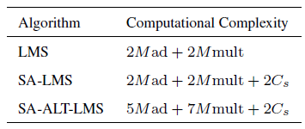
Computational complexity and shrinkage functions

Slide 9
Statistical analysis (1/3)
With w_{o} as the optimal filter and p_{o} as the oracle vector, the error vectors are
Error signal:
where is the error signal of the optimal filter and the oracle.
The MSE can be written as

Slide 10
Statistical analysis (2/3)
The expectation of the scalar values that are functions of triple vector products can be rewritten and the MSE expressed by
where ⊙ is the Hadamard product,
and
In what follows we proceed with simplifications that are valid for uncorrelated input signals.

Slide 11
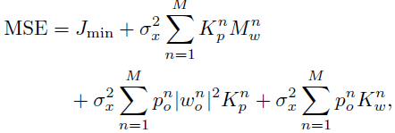
Statistical analysis (3/3)
After some simplifications the MSE can be written as
where w^{n}_{o} and p^{n}_{o} are the elements of w_{o} and p_{o}, respectively, and
where and
and are the elements of for w[i] and p[i]

Slide 12
Simulation Results (1/3)
We compare our proposed SA-ALT-LMS algorithms with:
The LMS
The SA-LMS
using the shrinkage functions:
the l1-norm [2],
The log-sum penalty [2], [5], [8],
the l0-norm [1], [6].
The input x[i] and the noise n[i] vectors are drawn from independent and identically distributed complex Gaussian random variables with zero mean and variances σ_{x}² and σ_{n}² , respectively.
The signal-to-noise ratio (SNR) is given by SNR = σ_{x}² / σ_{n}²
The filters are initialized as p[0] = 1 and w[0] = 0.
[5] E. M. Eksioglu, “Sparsity regularized RLS adaptive filtering,” IET Sig. Proc., vol.5, no.5, pp.480-487, August 2011.
[6] E. M. Eksioglu, A. L Tanc, “RLS Algorithm With Convex Regularization,” IEEE Signal Processing Letters, vol.18, no.8, pp.470-473, Aug. 2011.
[8] E. J. Candes, M. Wakin, and S. Boyd, “Enhancing sparsity by reweighted l1 minimization,” Journal of Fourier Analysis and Applications, 2008.

Slide 13
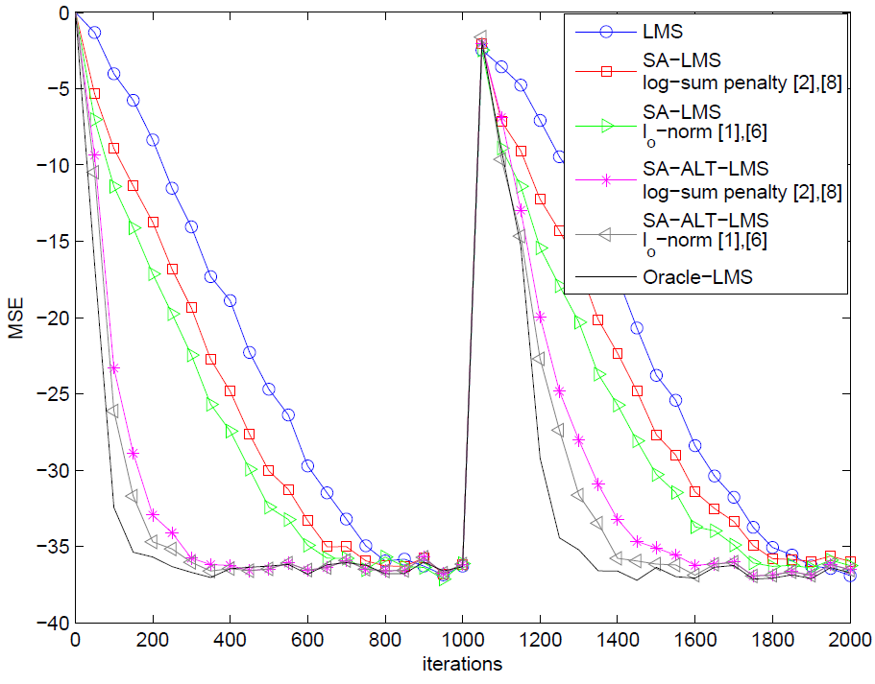
Simulation Results (2/3)
Time-invariant system with K = 2 non-zero out of N = 16 coefficients.
Correlated input obtained by x_{c}[i] = 0.8x_{c}[i − 1] + x[i] that are normalized.
After 1000 iterations, the system is suddenly changed to a system with N = 16 coefficients with K = 4 non-zero coefficients.
The positions of the non-zero coefficients are chosen randomly for each independent simulation trial.
The curves are averaged over 200 independent trials and the parameters are optimized.
Parameters: SNR = 40dB, σ_{x}² = 1, μ = 0.015, η = 0.012, τ = 0.02, λ = 0.02, ϵ = 10, and β = 10.

Slide 14
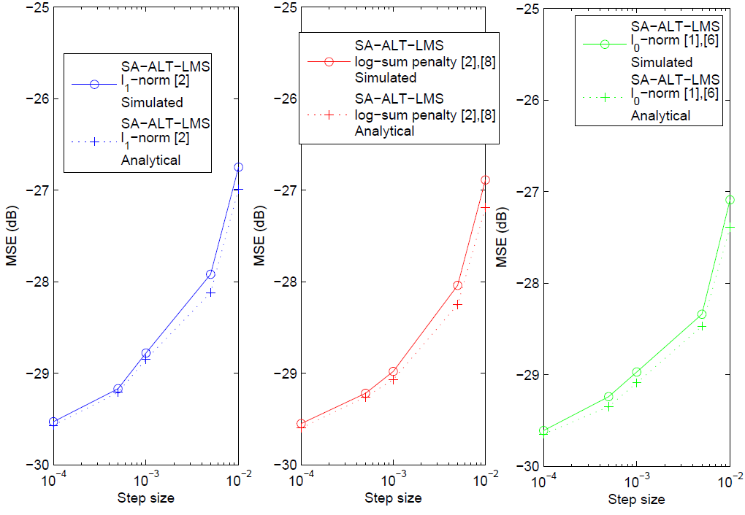
Simulation Results (3/3)
Analytical expressions vs simulations.
Approximations:
Time-invariant system with N = 32 that are randomly generated and only K = 4.
The positions of the non-zero coef. are random for each simulation trial.
The curves are averaged over 200 independent trials and the algorithms operate for 1000 iterations to ensure their convergence.
MSE performance against step size for μ = η. Parameters: SNR = 30dB, σ_{x}² = 1, τ = 0.02, λ = 0.02, ϵ = 10, and β = 10.

Slide 15
Conclusions
We have proposed a novel sparsity-aware adaptive filtering scheme and algorithms based on an alternating optimization strategy.
We have devised alternating optimization LMS algorithms, termed as SA-ALT-LMS, for the proposed scheme
We also developed an MSE statistical analysis, which resulted in analytical formulas that can predict the performance of the SA-ALT-LMS algorithms.
Simulations for system identification have shown that the proposed scheme and SA-ALT-LMS algorithms outperform existing methods.

Slide 16
References
[1] Y. Gu, J. Jin, and S. Mei, “ norm constraint LMS algorithm for sparse system identification,” IEEE Signal Process. Lett., vol. 16, pp. 774–777, 2009.
[2] Y. Chen, Y. Gu, and A. O. Hero, “Sparse LMS for system identification,” in Proc. IEEE Int. Conf. Acoustics, Speech and Signal Processing, Apr. 19-24, 2009, pp. 3125–3128.
[3] B. Babadi, N. Kalouptsidis, and V. Tarokh, “SPARLS: The sparse RLS algorithm,” IEEE Trans. Signal Process., vol. 58, no. 8, pp. 4013–4025, 2010.
[4] D. Angelosante, J. A. Bazerque, and G. B. Giannakis, “Online adaptive estimation of sparse signals: Where RLS meets the -norm,” IEEE
Trans. Signal Process., vol. 58, no. 7, pp. 3436–3447, 2010.
[5] E. M. Eksioglu, “Sparsity regularized RLS adaptive filtering,” IET Signal Process., vol. 5, no. 5, pp. 480–487, Aug. 2011.
[6] E. M. Eksioglu and A. L. Tanc, “RLS algorithm with convex regularization,” IEEE Signal Process. Lett., vol. 18, no. 8, pp. 470–473, Aug. 2011.
[7] N. Kalouptsidis, G. Mileounis, B. Babadi, and V. Tarokh, “Adaptive algorithms for sparse system identification,” Signal Process., vol. 91, no. 8, pp. 1910–1919, Aug. 2011.
[8] E. J. Candes, M. Wakin, and S. Boyd, “Enhancing sparsity by reweighted l1 minimization,” J. Fourier Anal. Applicat., 2008.
[9] R. C. de Lamare and R. Sampaio-Neto, “Adaptive reduced-rank MMSE filtering with interpolated FIR filters and adaptive interpolators,” IEEE Signal Process. Lett., vol. 12, no. 3, Mar. 2005.
[10] R. C. de Lamare and R. Sampaio-Neto, “Adaptive reduced-rank processing based on joint and iterative interpolation, decimation, and filtering,” IEEE Trans. Signal Process., vol. 57, no. 7, pp. 2503–2514, Jul. 2009.
[11] S. Haykin, Adaptive Filter Theory, 4th ed. ed. Upper Saddle River, NJ, USA: Prentice-Hall, 2002.

